Slide 1
Best Care at Lower Cost
The Path to Continuously Learning Health Care in America
J. Michael McGinnis, MD, MPP
October 11, 2012
Computing Community Consortium

Slide 2
Committee Members
Mark D. Smith (Chair)
President and CEO, California HealthCare Foundation
James P. Bagian
Professor of Engineering Practice, University of Michigan
Anthony Bryk
President, Carnegie Foundation for the Advancement of Teaching
Gail H. Cassell
Former Vice President for Science, Eli Lilly and Company
James B. Conway
Institute for Healthcare Improvement
Helen B. Darling
President, National Business Group on Health
T. Bruce Ferguson
Chairman, Department of Cardiovascular Sciences, East Carolina University
Ginger L. Graham
President and CEO, Two Trees Consulting
George C. Halvorson
Chairman and CEO, Kaiser Permanente
Brent James
Chief Quality Officer, Intermountain Healthcare, Inc.
Craig Jones
Director, Vermont Blueprint for Health
Gary Kaplan
Chairman and CEO, Virginia Mason Health System
‘
Arthur A. Levin
Director, Center for Medical Consumers
Eugene Litvak
President and CEO, Institute for Healthcare Optimization
David O. Meltzer
Professor of Medicine & Economics, U. Chicago
Mary D. Naylor
Director, Center for Transitions and Health, University of Pennsylvania School of Nursing
Rita F. Redberg
Professor of Medicine, UCSF
Paul C. Tang
Chief Innovation and Technology Officer , Palo Alto Medical Foundation

Slide 3
Best care at lower cost
The path to continuous learning health care in America
Challenge context – irrationality, quality, costs, complexity
Why now? – costs, complexity, computing, CQI, culture, policy
The vision – a continuously learning health system
The path – digital infrastructure, care improvement tools, supportive policy
CCC leadership – networks, tools, people, policy
IOM synergy – leadership Roundtable, Innovation Collaborative projects

Slide 4
Imagine
These sectors operating like health care
Banking – ATM transactions slowed by misplaced records
Home building – carpenters, electricians, and plumbers all working independently and with different blueprints
Retail stores – no product prices posted, and charges varying widely by method of payment
Auto manufacturing – no warranties for defects or product line quality assessment
Airline travel – pilots all designing their own pre-flight safety checks

Slide 5
Imagine
Health care operating with best sector practices
Records immediately updated and available for use by patients.
Care delivered proven reliable at the core and tailored at the margins.
Patient and family needs and preferences a central part of the decision process.
Team members all fully informed in real time about each other’s activities.
Prices and costs transparent to all participants.
Payment incentives structured to reward outcomes and value, not volume.
Errors promptly identified, reported, and corrected.
Continuous improvement based on real-time practices and outcome monitoring.

Slide 6
Challenge context
Quality
Costs
Complexity

Slide 7
Challenge context
Quality – persistent shortfalls

Slide 8
Quality
Patient harm – One-fifth to one-third of hospital patients harmed during their stay, largely preventable.
Recommended care – Only about half of recommended preventive, acute, and chronic care actually delivered.
Outcome shortfalls – If care quality matched highest statewide performance, there would have been 75,000 fewer deaths nationally.

Slide 9
Challenge context
Costs: unsustainable levels, waste

Slide 10
Costs
Absolute, relative, wasted, opportunity
Absolute expenditures – $2.6 trillion 18% GDP
Relative expenditures – 76% increase health costs in past 10 years, overwhelming the 30% gain in personal income
Wasted expenditures – $750 billion (2009)
Opportunity costs – e.g. total waste could pay salaries of all first response personnel for 12 years – and fund a great deal of biomedical research.

Slide 11
Challenge context
Complexity: exponentially increasing

Slide 12
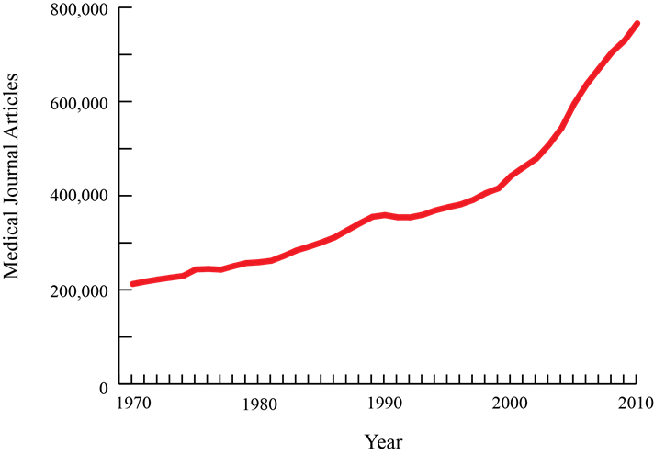
Complexity
Increasing information

Slide 13
Complexity
Diagnostic factors in play per person
Stead, W. (2007)

Slide 14
Complexity
Treatment factors in play per person
More conditions – e.g. 79 year old patient with 19 meds per day for osteoporosis, diabetes, hypertension, and COPD
More clinicians – e.g. over 200 other doctors are also providing treatment to the Medicare patients of an average primary care doctor
More choices – e.g. for prostate cancer: watchful waiting, laparoscopic or robotic assisted surgery, brachytherapy, IMRT, proton beam therapy, cryotherapy, androgen deprivation therapy
More activities – e.g. ICU clinicians with 180 activities per person, per day

Slide 15
An all-too-typical experience
Representative timeline of a patient’s experiences
in the U.S. health care system

Slide 16
Why now?
New Tools
Computing
Better connectivity to information and among participants
Stronger processing capacity for new knowledge
System performance improvement tools
Patient-clinician culture change strategies in play
Policy levers for incentives, transparency, accountability, engagement

Slide 17
The vision
A continuously learning health care system
Science and informatics
- Real-time access to knowledge
- Digital capture of the care experience
Patient-clinician partnerships - Engaged, empowered patients
Incentives
- Incentives aligned for value
- Full transparency
Culture
- Leadership-instilled culture of learning
- Supportive system competencies

Slide 18
The vision
Moving from the linear

Slide 19
The vision
Moving from the linear

Slide 20
The vision
Moving from the linear

Slide 21
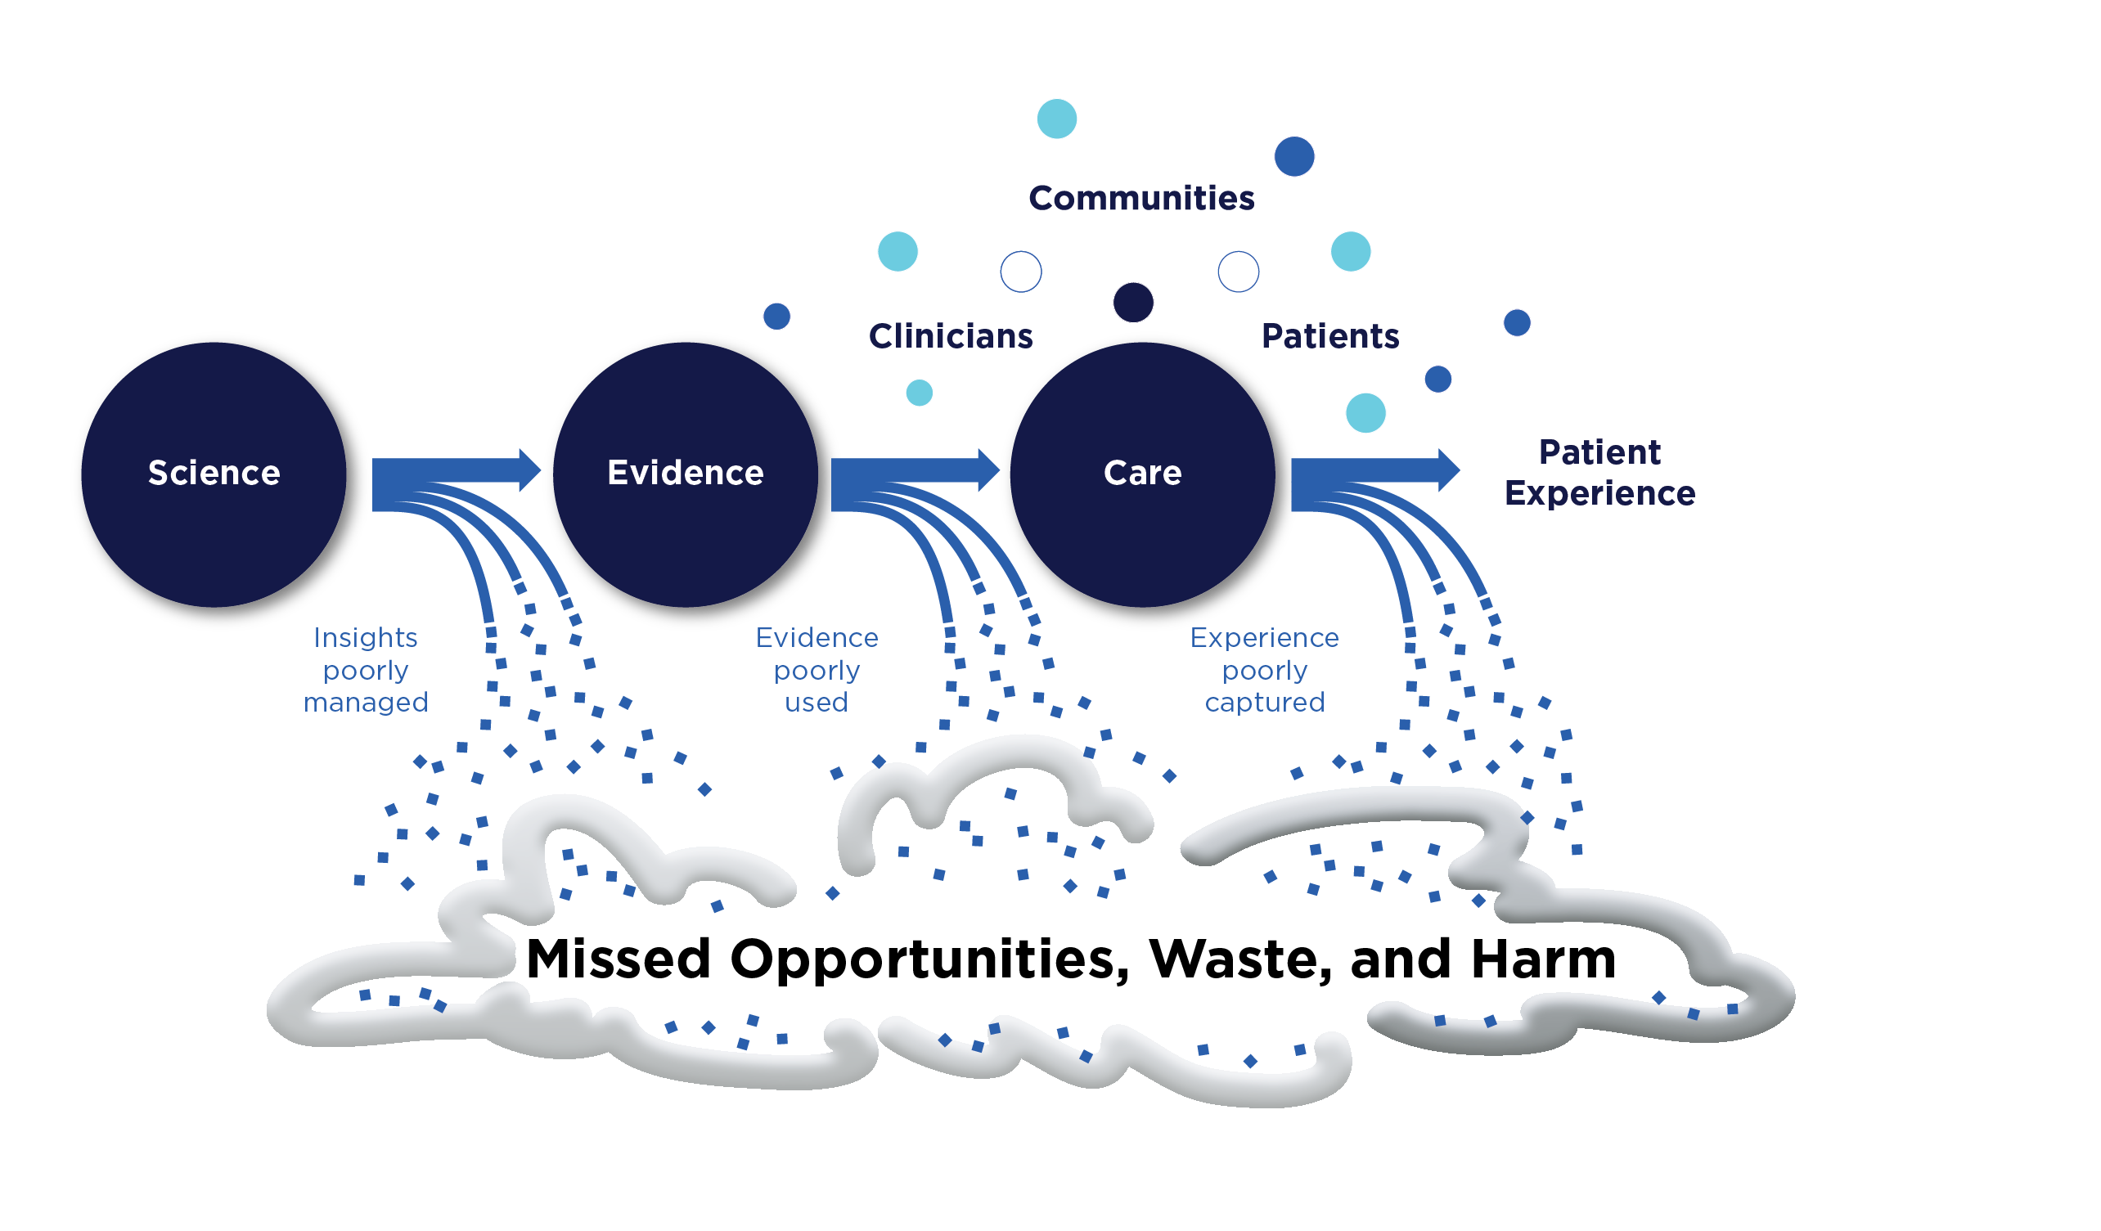
The vision
From missed opportunities, waste, and harm

Slide 22
The vision
To continuous learning, best care, lower cost

Slide 23
The path
Foundational elements
Care improvement targets
Supportive policy environment

Slide 24
The path
Foundational elements
The digital infrastructure – Improve the capacity to capture clinical, delivery process, and financial data for better care, system improvement, and creating new knowledge.
The data utility – Streamline and revise research regulations to improve care, promote the capture of clinical data, and generate knowledge.

Slide 25
The path
Care improvement targets
Clinical decision support – Accelerate integration of the best clinical knowledge into care decisions.
Patient-centered care – Involve patients and families in decisions regarding health and health care, tailored to fit individual preference.
Community links – Promote community-clinical partnerships and services aimed at managing and improving health at the community level.
Care continuity – Improve coordination and communication within and across organizations.
Optimized operations – Continuously improve health care operations to reduce waste, streamline care delivery, and focus on activities that improve patient health.

Slide 26
The path
Supportive policy environment
Financial incentives – Structure payment to reward continuous learning and improvement in the provision of better care at lower cost.
Performance transparency – Increase transparency on health system performance.
Broad leadership – Expand commitment to the goals of a continuously learning health care system.

Slide 27
CCC leadership
Networks
Tools
People
Policy

Slide 28
CCC leadership
Bringing transformational research to practice
Networks – e.g. technical assistance in expanding distributed research networks and innovative research methods; development of virtual learning community for knowledge generation in ACO’s.
Tools – e.g. development of “big data” mining tools and strategies through industry-HCO-payer-public partnerships (NIH, NSF, DARPA, Hughes, Google, Microsoft, IBM, Amazon, insurers, etc); models for computing-based care coordination.
People – e.g. democratization of data-driven medicine through mobile computing and construct of user-friendly data access/interpretation Apps; models for clinic-community approaches for identification and treatment of high-risk resource-intensive patients.
Policy – e.g. data quality/standards/interoperability strategies and testing; citizen-level support strategies for reducing barriers to building a cloud-based clinical data research trust; fostering “information donor” initiative; strategies to reward provider organizations generating reliable knowledge from routine clinical care; prominent emphasis on continuous learning as centerpiece of evolving clinical research paradigm

Slide 29
IOM synergy
IOM Roundtable on Value & Science-Driven Health Care
Health professionals – Best Practices Innovation Collaborative
Evidence-messaging – Evidence Communication Innovation Collaborative
Digital infrastructure – Digital Learning Collaborative
Clinical research – Clinical Effectiveness Research Innovation Collaborative
Value enhancement – Value Incentives Learning Collaborative
System optimization – Systems Engineering for Health Innovation Collaborative

Slide 30
Learn more at…
iom.edu/bestcare

