Slide 1
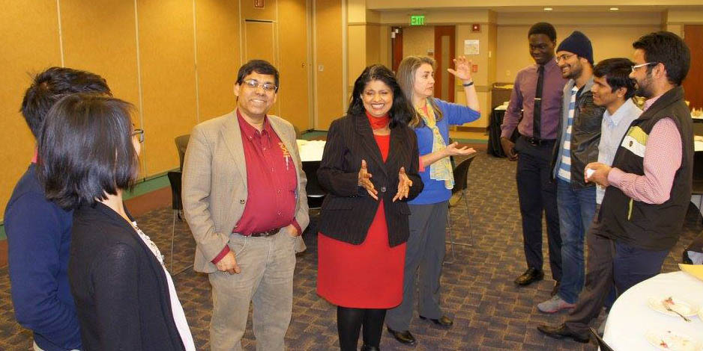
Distinguished Lecture Series (DLS)
The DLS program provides two prominent speakers to give technical talks, participate in a panel discussion on graduate school, and network with the host community. Students have the opportunity to discuss the graduate school process and receive mentoring from leading women and minority researchers.
Submit a DLS Proposal at cra-w.org/dls
Funds are available to support DLS speaker travel and local arrangements
Recent Events:
March 11, 2015 – Missouri S&T Computer Science with Dr. Bushra Anjum and Dr. Patty Lopez
March 27-28, 2015 – 2nd WiCyS with Dr. Barbara Endicott-Popovsky and Dr. Carrie Gates
The Distinguished Lecture Series aims to provide inspiring role models that will encourage women and minority students to pursue research in computer science and engineering.

