Slide 1
Time Management and Family Life
Bobby Schnabel
@ACM_CEO
CRA Academic Careers Workshop, February, 2016

Slide 2
Time Management Advice I Gave Early-Career Faculty as Department Chair
Teaching is important, but don’t let it take all of your time
Teach each course you develop several times
Don’t reinvent too many wheels
Limit hours available to students (work outside your office sometimes?)
Make sure your work with research students is focused towards producing research output: ideas, software, publications

Slide 3
Time Management Advice I Gave Early-Career Faculty as Department Chair, continued
Be a good departmental citizen but don’t overdo it; people will love you but it won’t get you tenure
Get started with professional service before tenure review but don’t overdo it; select opportunities that help your research career
Productive time, not hours logged, is the key – know yourself, your need for balance in life, how productive your work time really is

Slide 4
Time / Career Management Advice I Gave Early-Career Faculty as Department Chair
Don’t try to be a full professor as an
assistant professor
(Next three slides are for reference only)

Slide 5
Things I Did as an Untenured Professor
Research
Grant support from other faculty first summer, first grant in second year, multiple grants started later
About 3-4 graduate students / year by 3rd year
Wrote reasonable number of papers and one book
Designed software, students did programming
About 3 conference, 5 colloquium talks / year
Developed research collaboration with local laboratory
Got a great colleague!

Slide 6
Things I Did as an Untenured Professor, cont’d
Teaching
Taught 6 courses (only 4 really different), most several times
Service
Departmental search, executive committees (young dept)
Local arrangements chair for national meeting
Vice pres. and president of regional professional group
First editorial position start of 6th year
Organized several conference sessions, gave one short course

Slide 7
Things I Did as a Beginning Full Professor
Headed department-wide research infrastructure grant
Supervised ~7 graduate students/year, multiple/larger grants
Wrote more papers, with more student participation
Taught fewer courses (but moved into new area)
Branched into new research area and stayed in old one
About five conference talks / year, turned down others
Lots more university and professional service: multiple department /college/campus committees; first college-level leadership role; several professional society officer/board/committee positions; started new professional society group; four editorial positions

Slide 8
Perspectives I Shared with New Faculty as Dean
Make sure you have a good mentoring relationship
Make sure you get to repeat teaching courses
Get advice, and partner, on grant proposals
Use startup funds wisely, but use them!
Don’t be reluctant to request leaves or flexibility for family and personal reasons
Slow starts are common: don’t despair, but don’t dally
Tenure is / should be about impact

Slide 9
General Time Management Principles
Organize
What needs doing (lists! – daily, weekly, monthly)
Where you’ll be working
Prioritize
Do what’s most important, not what’s easiest / noisiest
Constrain
Know how much time a task is worth / you can afford
Delegate
Students; departmental staff; household help
Just say no (nicely)

Slide 10
Reflections on Family / Life and Career

Slide 11
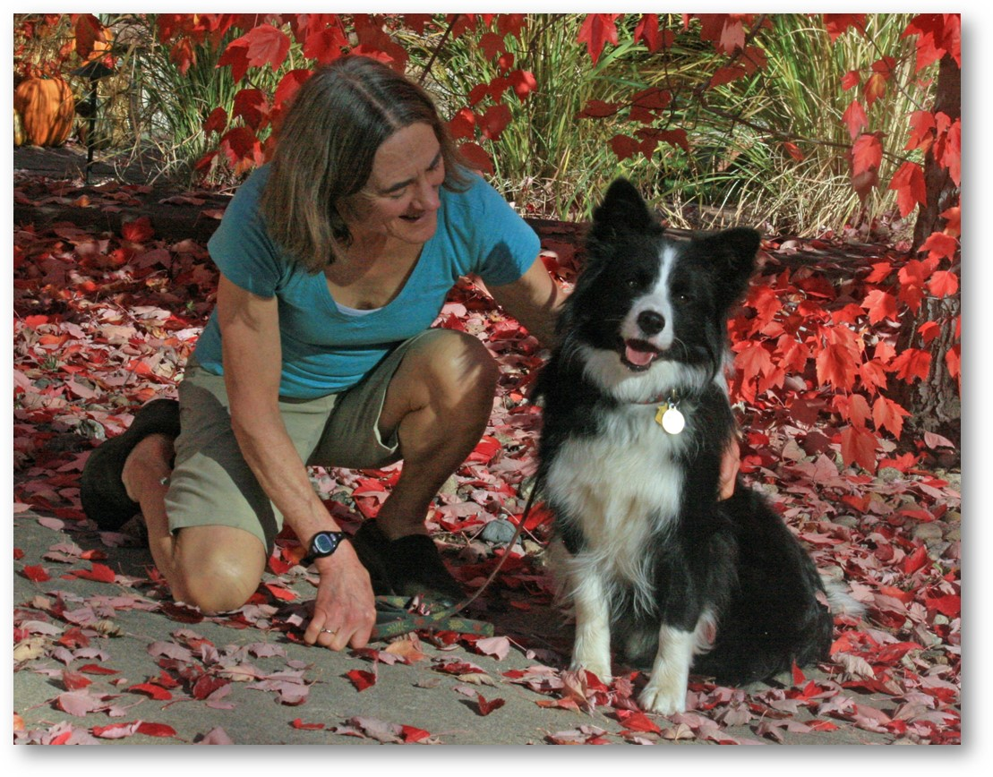
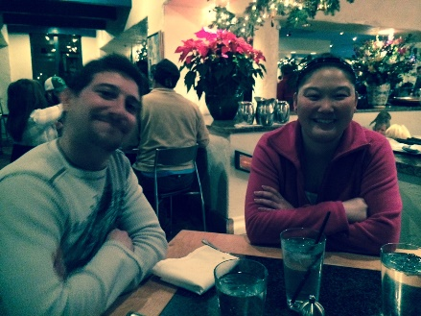
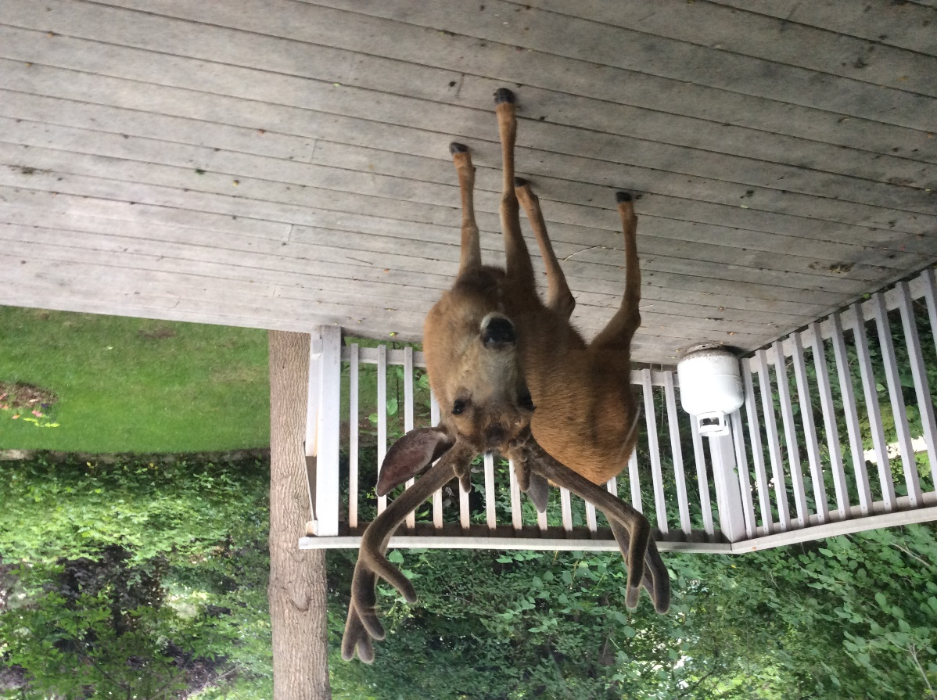
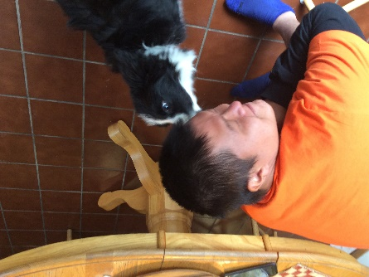
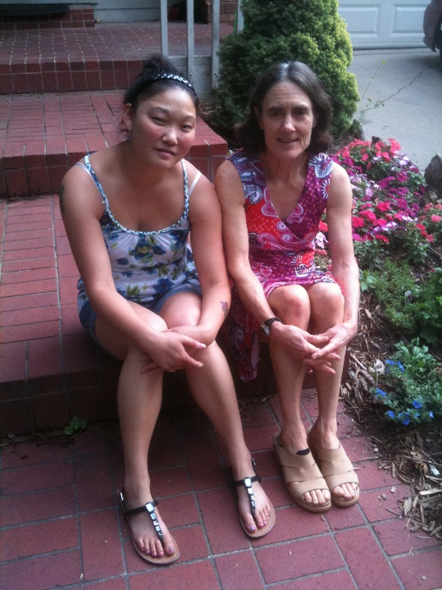

Slide 12
Reflections on Family / Life and Career
You need to decide what is important to you and enforce your priorities, the world won’t do this for you
some personal examples :
NSF PI meeting on Mother’s Day
Early morning meetings vs. child care
Children still needs lots of attention after they turn ____ (1? 5? 13? 20?)

Slide 13
Reflections on Family / Life and Career, continued
Dual careers and children requires accommodation, compromise, planning
Travel; work schedules; family responsibilities
Can you have an academic career and still have time for
Children’s activities? Community service? __________?
Answer: see first bullet on this topic

Slide 14
Closing Thoughts on Life and Career
What do tombstones say?
You all are major successes already

Slide 15
